Slide 1

Easy Park
A parking automation system suitable for AAP, Inc’s business model

Slide 2
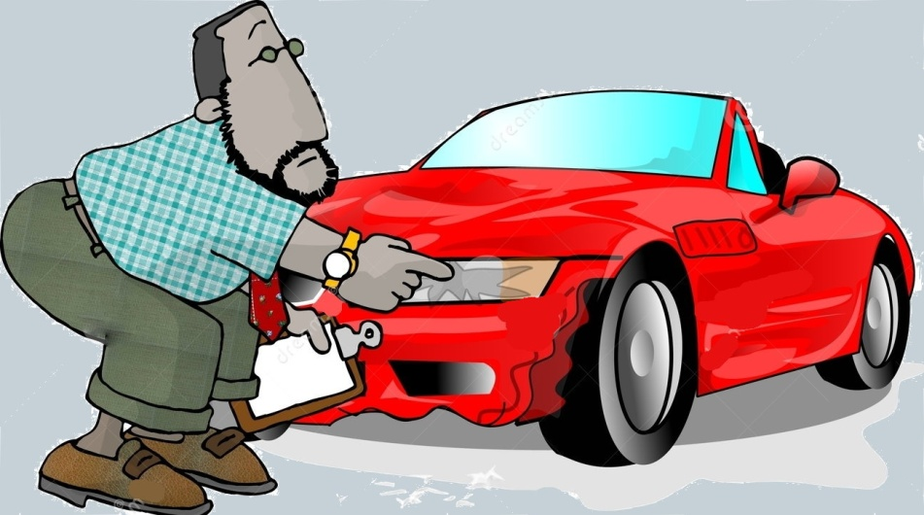
How does current system work
Employee checks his car out in the main gate.
Damage control unit checks the car’s body damages
Spotted damages and also Employee specifications are recorded in the ticket and a copy of ticket are provided to customer

Slide 3

How does current system work
Parking manager checks out the car key and remaining of the ticket to the driver
Runner transfers the car to VMware parking garage and checks it out to the Parkman

Slide 4
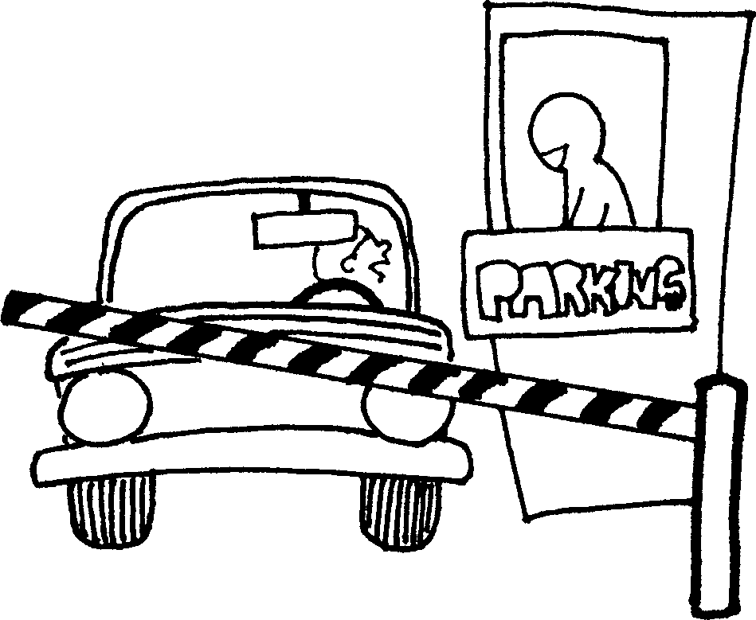
How does current system work
VM-lot parks the car in a suitable parking slot
Runner gets on van and returns to the main gate
Employee refers to main gate to get his car
Runner gets on van and returns
to VMware parking garage

Slide 5

How does current system work
Runner transfers the car to the main gate
Car is being checked out to the customer

Slide 6
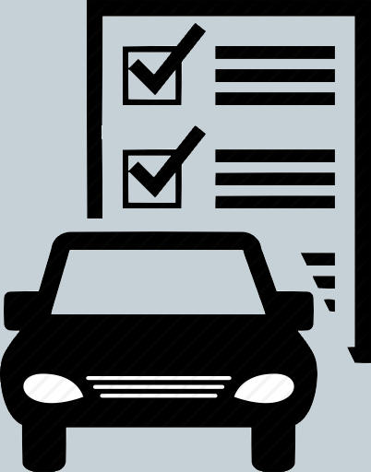
Difficulties of current system
Damage control process and also filling out the relevant forms are time consuming tasks
Customers have to be in waiting
queue for a long time in order to
check out their cars and/or declare
their specifications.
Drivers’ current statuses are not
clear. Thus, parking manager has
to manage drivers manually.

Slide 7
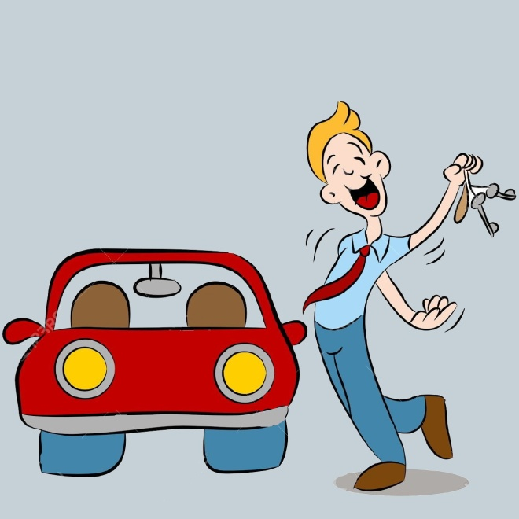
Difficulties of current system
Drivers don’t know about their assigned tasks as long as they haven’t interacted with parking manager
Vans’ current positions and statuses are not clear
There is no acceptable notification mechanism for customers to inform staff previously
that they are going to need their cars.
Thus they have to wait for a long time
in the main gate for their cars to be
returned

Slide 8


Checks out
Employee
Manager

Slide 9
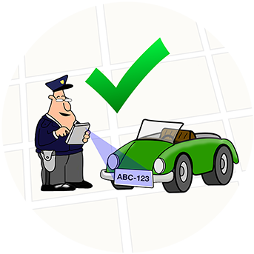


Damage Control
Manager
Swipe
Checks out
Runner

Slide 10
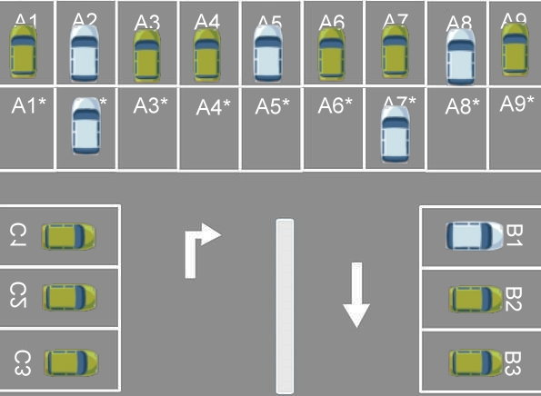

Drive
Swipe
Park
Runner
Checks out
VM-Lot

Slide 11

How is the new system going to work
Employee checks his car out in the main gate.
Parking manager issues a car scan command to system.
System scans car’s license plate and also takes photos from four sides of the car

Slide 12
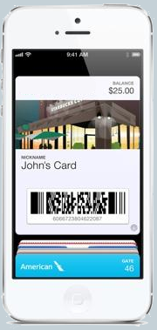
How is the new system going to work
System fills out the digital ticket’s form according to license plate, which include Employee specifications and preferred departure time.
Parking manager assigns a suitable
Runner to transfer the car to
the parking (Considering
drivers statuses system reports).

Slide 13

How is the new system going to work
Runner swipes his ID card in order to inform the system that he has checked in the car to transfer.
Runner transfers the car to the parking.
Runner swipes his ID card again
to inform the system that he has
checked in the car to the
Parkman.

Slide 14

How is the new system going to work
System suggests car’s best parking position (slot) for the Parkman
VM-lot parks the car in a suitable parking slot, considering system suggestion and digital ticket’s specifications
Employee notifies the system
that he is going to need his car
in a certain amount of time

Slide 15
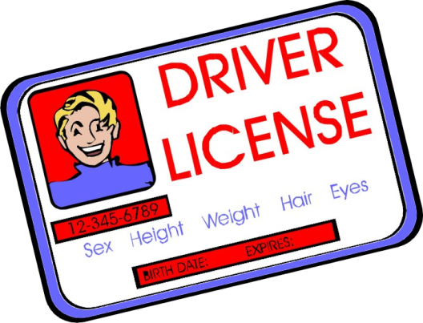
How is the new system going to work
Parking manager being informed about costumer’s notification, issues a car removal command from the parking
VM-lot being informed about manager’s command, removes the car from parking and assigns a suitable Runner (considering drivers statuses system provides)
Runner swipes his ID card to inform the system that he has checked out the car from the Parkmanto transfer the car to the main gate

Slide 16
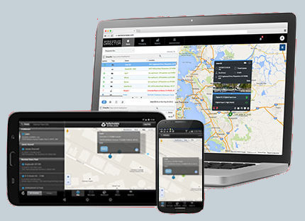
How is the new system going to work
Runner transfers the car to the main gate
Runner swipes his ID card again to inform the system that he has checked in the car in the main gate
Parking manager registers in the system that he has checked in the car to the customer

Slide 17

Unique features of automated system
Tracking vans’ positions and statuses in real-time.
Reporting Drivers’ current statuses and their last assigned task. (Considering drivers have to swipe their cars when they are getting into van and also when they are getting out of it.)
The ability to assign multiple tasks to drivers as queues, so that drivers always know about their assigned tasks, current tasks and also tasks they have finished at the moment.
Customers can schedule their preferred departure time in various days of the week.
Intelligent determination of best position to park a car

Slide 18
Difficulties that automated system resolves
Damage control process and filling out relative forms are being done in fraction of a second.
Customers don’t have to be in waiting while checking out their cars or to declare their specifications. This is because system extracts Employee specifications from his car’s license plate and also takes photos of car’s body.
Drivers’ current statues and positions are clear. Thus parking manager doesn’t need to manage them manually.
Drivers always know about their task statuses while swiping their ID cars and as a result don’t need to interact with manager regarding this matter.
Vans’ positions and statuses are always clear.
Customers have a proper notification mechanism to send their requests. Therefore they are not going to wait to check in their cars. Because the car is previously removed from the parking and is already in the gate.

